Slide 1
EE596 : Image and Video Coding Mini project
E/17/199
H.M.P.S. Madushan

Slide 2
Content
Introduction to Image Compression
Stage 1: Basic implementation of Image compression system
Introduction to Video Compression
Stage 2: Basic implementation of Video compression system
Stage 3 : Improved hybrid video codec
References

Slide 3
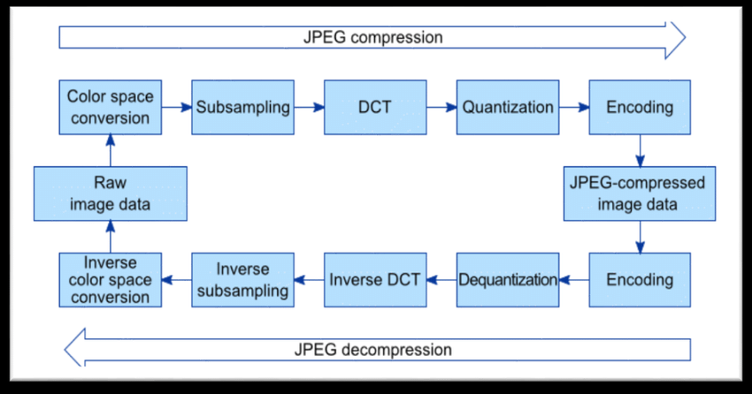
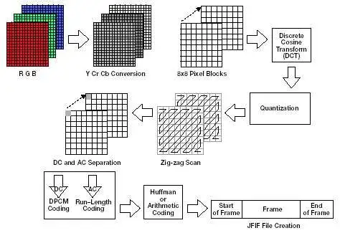
Introduction to Image Compression

Slide 4
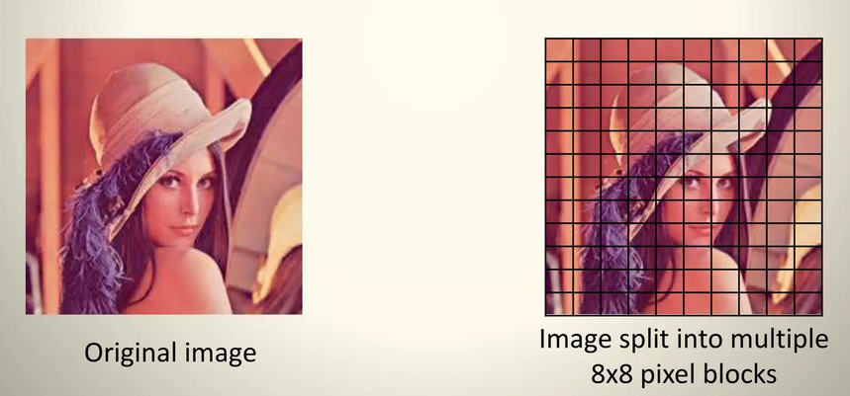
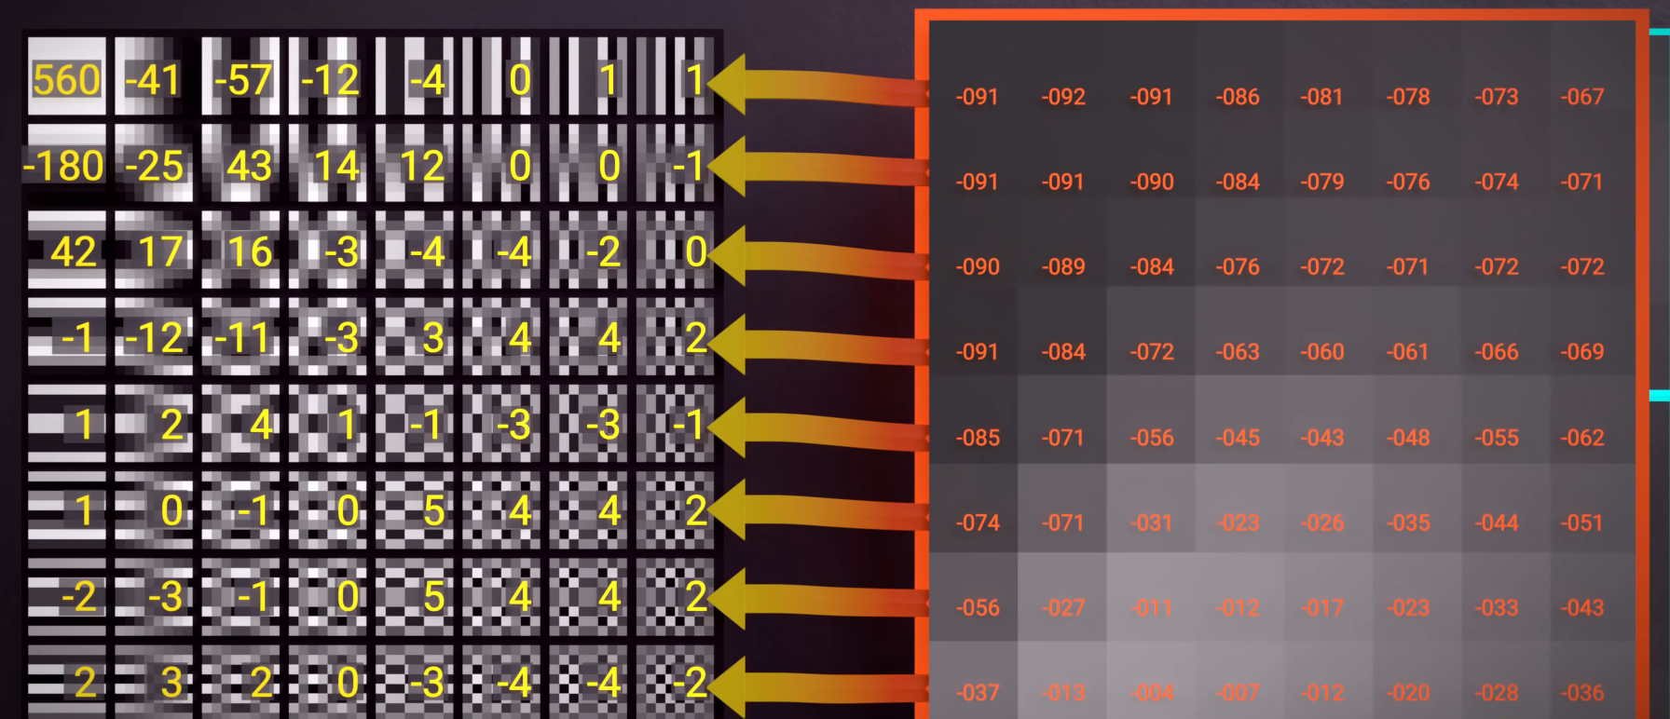
Basic implementation of Image compression system
Color Space conversion
Human eyes are more receptive to luminance
( brightness and darkness) and less receptive to
chrominance (color).
Load RGB image and convert it to gray scaled image
Discrete Cosine Transform
Human vision is insensitive to high spatial frequencies
Divide image into 8x8 macro blocks which conations
64 pixels values, with 0-255 range
Apply DCT transform to each 8x8 macro blocks
Figure 01: Divide image to 8x8 macro blocks
Figure 02: DCT applied for one macro block

Slide 5
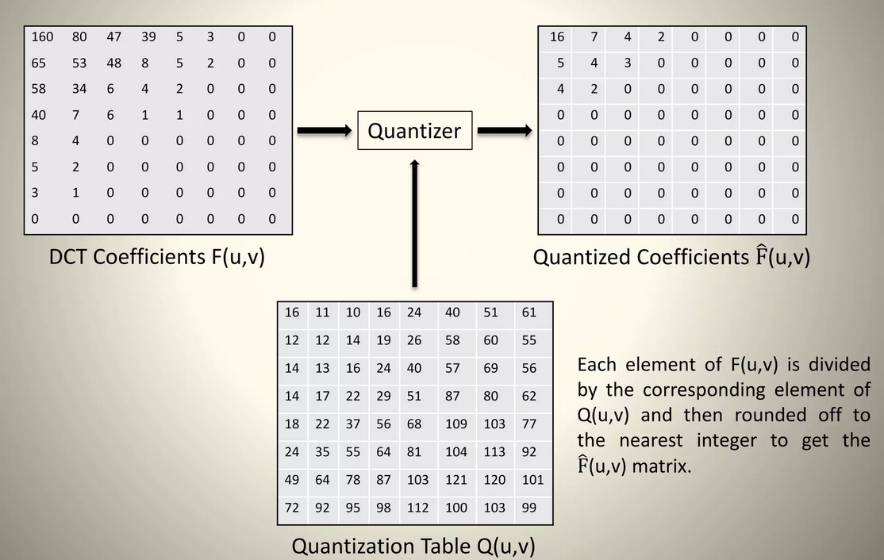
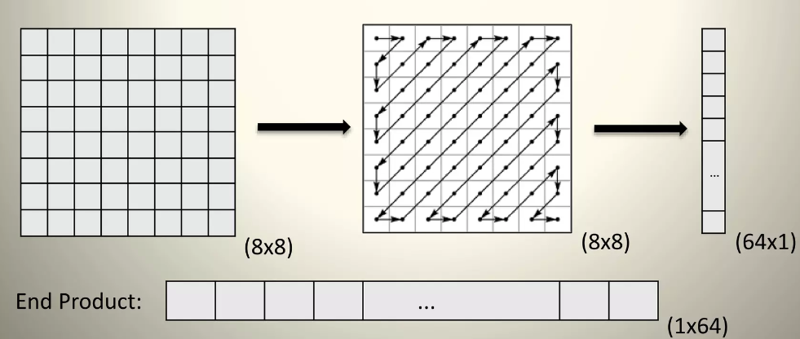
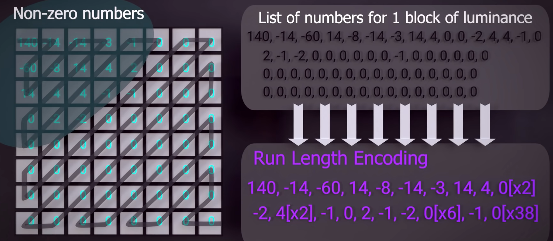
Quantization
Divide each values in each macro block by Quantization matrix which multiplied with different quantize level values .
Rounded off each result to nearest integer
AC and DC values separation
Extract the DC parts which is the first element in the Quantized
coefficients matrices at upper left conner
AC coefficients were extracted using Zig-Zag scanning
Perform Differential coding on DC components
Perform Run length coding on AC components
Figure 03: Apply Quantization to the DCT coefficients
Figure 04: Zig-Zag scanning of AC elements
Figure 05: Run length coding on AC components

Slide 6
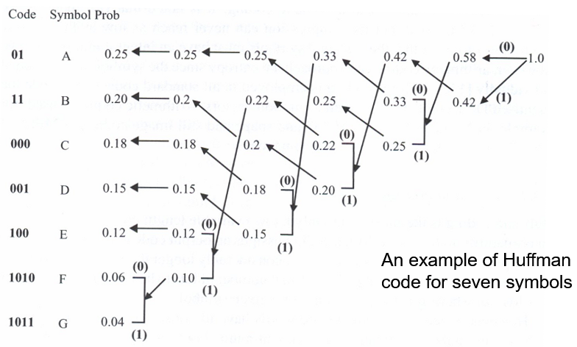
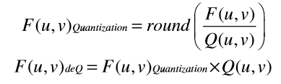
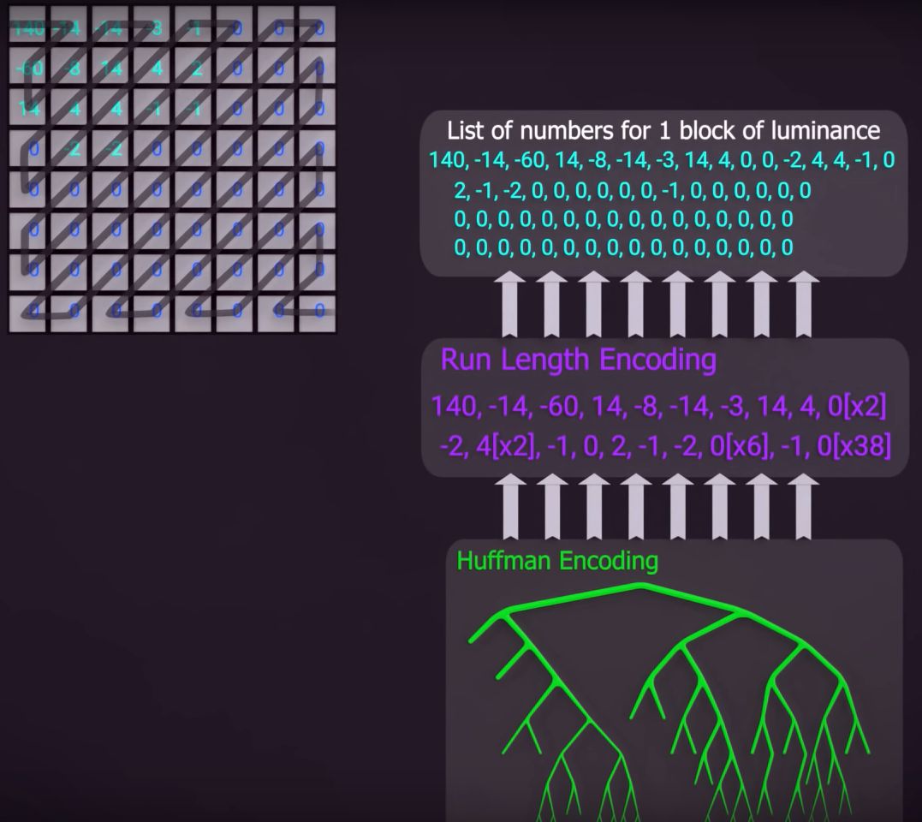
Huffman Encoding
Calculate AC/DC symbol probability and generate AC/DC Huffman codebooks
Apply Huffman coding for AC and DC components separately
Save encoded AC and DC data as a bit streams
Decoding
Apply Huffman decoding for both AC & DC components separately
Do inverse Differential coding for DC elements
Do inverse Run length coding for AC elements
Combine all Decoded AC & DC elements to generate macro blocks
Apply inverse Quantization process which involves multiply by the Quantization matrix and with the corresponding Quantization level
Apply inverse DCT transform to each macro block
Combine all macro blocks to generate one cell array which gives the decoded image
Figure 06: Huffman coding algorithm
Figure 07: Decoding Process

Slide 7






Observations
Figure 08: Original RGB Lena image
Figure 09: Original grayscale Lena image
Figure10: Decoded image with Q-Levels = 4
High Quality
Figure 11: Decoded image with Q-Levels = 8
High Quality
High Q-level will increase the quantization step size and results a coarser quantization
Coarse quantization leads to a higher levels of compression ratios.
Information loss is increased and resulting lower image quality with lower PSNR value.
Figure 12: Decoded image with Q-Levels = 16
Medium Quality
Figure 13: Decoded image with Q-Levels = 32
Law Quality

Slide 8
Results
Table 01 :Variation of Compression ratio and PSNR values with Q-level
Quantization Level | Compression ratio | PSNR value | Quality
4 | 2.93 | 31.26 | High
8 | 5.20 | 28.46 | High
16 | 10.06 | 24.90 | Medium
32 | 23.69 | 20.95 | Low
Figure 14:Variation of Compression ratio with Q-level
Figure 15: Variation of PSNR value with Q-level

Slide 9
3.1.2. Adjust the compression ratio of your image encoder to meet the following bit rates. Assume that you will be transmitting one image per second and the output should be at the best possible PSNR value.
Bit rate of the channel = 199 + 300 kbps = 499 kbps
Target Bit Rate per Image = Total Bit Rate / Number of Images per Second = 499 kbps / 1 image/sec
= 499 kb
Compression ratio (@ 499kb ) = 0.53
Q –level = 0.28388
PSNR value = 39.62
Table 02 :Variation of Compression ratio and Bit rate values with Q-level
Q- Level | Compression ratio | Bit rate (kb)
8 | 5.20 | 50.445
4 | 2.93 | 89.584
2 | 1.78 | 147.080
1 | 1.13 | 232.726
0.5 | 0.73 | 358.816
0.25 | 0.49 | 536.778
0.285 | 0.53 | 497.978
0.28388 | 0.53 | 499.047
Figure 16: Variation of Bit rate with Compression ratio

Slide 10
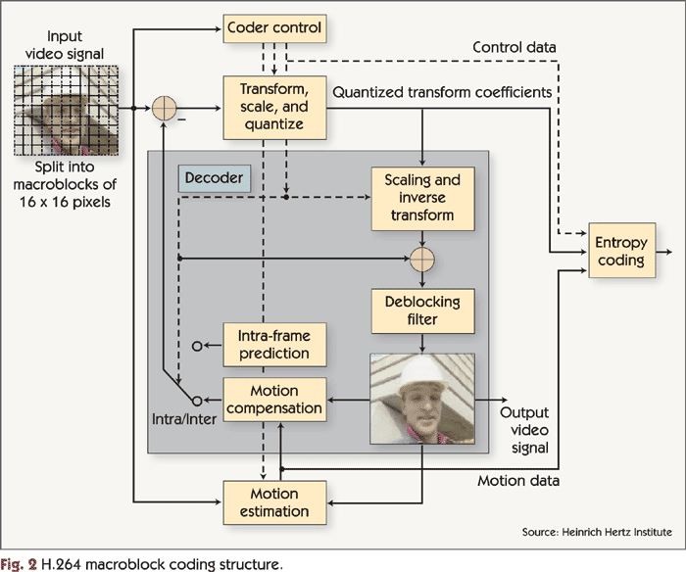
Introduction to Video Compression

Slide 11
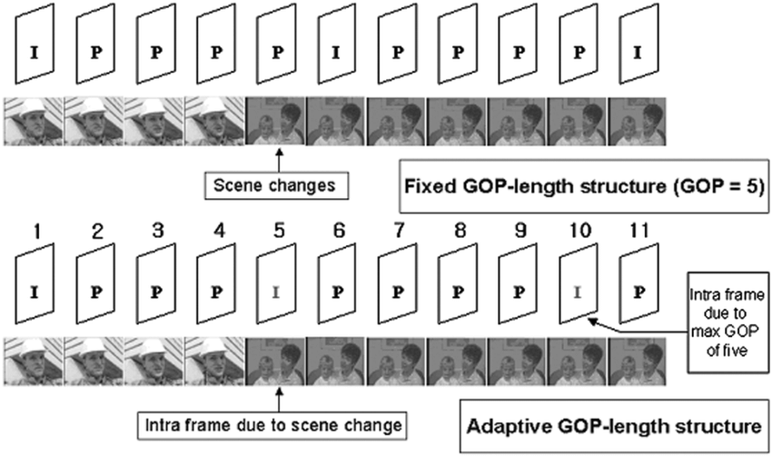
Basic implementation of Video compression system
Read video into frames
Setup the Q-level, macro block size and search area parameters
Each frame is converted RGB to gray scale
Divide each frame into 8x8 macro blocks
Group of Pictures (GOP) structure used is IPPP (the first frame in each group is an I-frame (Intra-coded frame), followed by three P-frames (Predictive-coded frames)
If I-frame, do encode by,
DCT Transform
Quantization
AC/DC Extraction
Differential coding on DC components
Run length coding on AC components
Huffman coding for AC & DC components separately
Store AC and DC encoded bit streams
Figure 17: IPPP Group of Picture structure

Slide 12
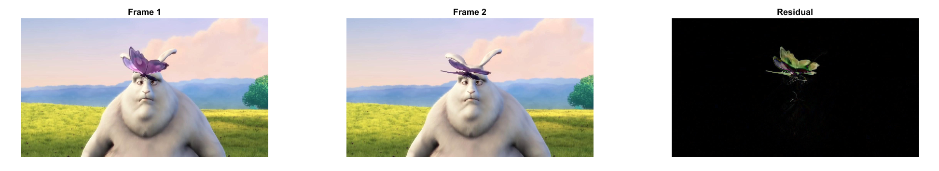
If P-frame, do encode by
Motion estimation using full search algorithm is used to calculate Motion vector and Residual image between predicted P-frame and current P-frame
Huffman encode the residual frame using same procedure as before (which is done to I-frame)
Huffman encode Motion vectors
Store the I-frame encoded AC/DC bit streams, P-frame Residual encoded AC/DC bit stream and motion vector encoded bit streams
Figure 18: First frame
Figure 19: Predicted frame
Figure 20: Residual image

Slide 13
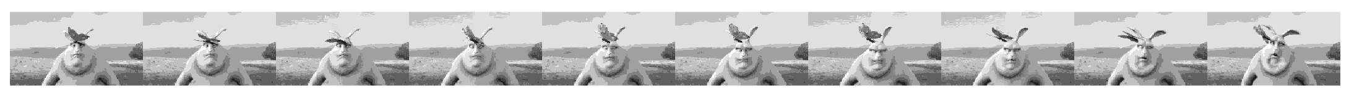
9. Decoding process, encoded I-frame bit streams are decoded,
Huffman decoding AC & DC components separately
Inverse Run length coding for AC components
Inverse Differential coding for DC components
Inverse extraction process of AC & DC components and rebuild the matrix
Inverse Quantization
Inverse DCT transform
10. Decoding process, encoded P-frames are decoded,
Huffman decoding is done to decode the encoded residual of P-frame and encoded motion vectors separately
Inverse motion estimation is done to Recreate the P-frames
11. Decoded output frame sequence is created by removing the macro blocks
Figure 21: Compressed output frame sequence for IPPP structure of all 10 decoded frames with Q-level = 16

Slide 14
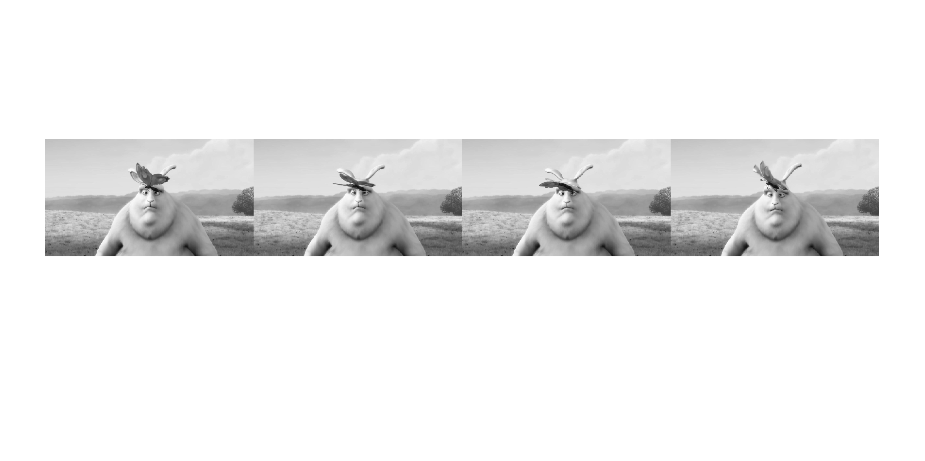
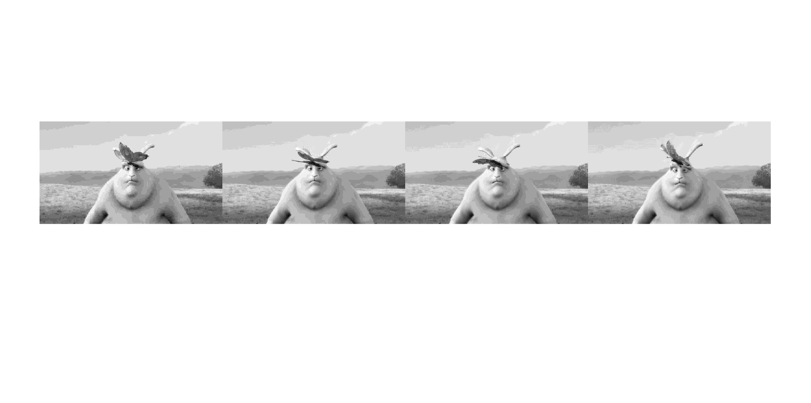

I
P
P
P
Figure 22: Frame sequence for IPPP structure of first 4 original frames
I
P
P
P
Figure 23: Compressed frame sequence for IPPP structure of first 4 Decoded frames with Q-level =8
I
P
P
P
Figure 24 : Compressed frame sequence for IPPP structure of first 4 Decoded frames with Q-level = 16

Slide 15

Improved hybrid video codec
Fixed Bit rate
3.3.1. Optimize the quantization process of the codec to facilitate transmission in fixed bandwidth environment. Find best Q-level value to meet given bit rate.
Bit rate of the channel = 199 + 300 kbps = 499 kbps
Target Bit Rate per frame = Total Bit Rate / Number of frames per second
= 499 kbps / 30 frames/sec
= 16.663 kb per frame
Optimal Q –level value = 40
Figure 25: Compressed output frame sequence for fixed bit rate of 16.633kb per frame with Q-level = 40

Slide 16

Fixed Quality level
3.3.2. Optimize the coding process to give the best bit-rate for a given quality level.
Required PSNR quality level = 40
Q –level value = 2
Maximum possible PSNR value = 44.2098
PSNR = 40.9037
PSNR = 41.4736
PSNR = 41.4376
PSNR = 41.1946
Figure 26 : Compressed output frame sequence for fixed quality level of PSNR = 40 with Q-level = 2

Slide 17
References
Hood, A. (2017) Image and Video Compression, Ppt Video Online Download.
Available at: https://slideplayer.com/slide/5928829/
(Accessed: 22/06/2023, 16:15)
Image and Video Compression (2020).
Available at: https://www.powershow.com/view4/4424ea-YTM5Y/Image_and_Video_Compression_powerpoint_ppt_presentation. /
(Accessed: 23/06/2023, 08:45)
Branch Education (2021) How are Images Compressed? [46MB ↘↘ 4.07MB] JPEG In Depth.
Available at: https://www.youtube.com/watch?v=Kv1Hiv3ox8I.
(Accessed: 23/06/2023, 20:40)
GeeksforGeeks (2023) “Huffman Coding Greedy Algo 3,” GeeksforGeeks [Preprint].
Available at: https://www.geeksforgeeks.org/huffman-coding-greedy-algo-3/.
(Accessed: 24/06/2023, 09:50)
Lee, J.-H., Shin, I. and Park, H. (2006) “Adaptive Intra-Frame Assignment and Bit-Rate Estimation for Variable GOP Length in H.264,” IEEE Transactions on Circuits and Systems for Video Technology, 16(10), pp. 1271–1279. Available at: https://doi.org/10.1109/tcsvt.2006.881856.
(Accessed: 25/06/2023, 23:35)

Slide 18
THANK YOU !

